Slide 1
Minneapolis Police Stops
Group F: James Curtis, Raleigh Love, Emanshu Patel, Erica Unterreiner

Slide 2
Motivation and Summary – James write, team edit
Our project was to understand whether or not diversity indicators (such as race, gender), time and precinct correlate to police stops in Minneapolis.
We sought to answer questions such as which factors (if any) relate to traffic stops and whether or not any of these factors correlated to persons or vehicles were searched.

Slide 3
Minneapolis Police Stop Data
Are there proportional differences in race given the stops recorded by precinct? What about gender?
Are there more stops during the morning, afternoon, evening or night shifts?
What is the likelihood of an officer stop by race? And what is the likelihood that the pre-race determination matched the actual race documented after the stop?
Does the type of police stop (traffic vs suspicious) impact whether a person is searched?

Slide 4
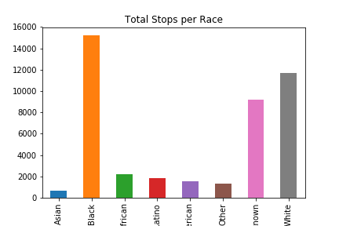
Data Exploration - Overview
Notes:
Describe the exploration and cleanup process:
read the file into a pandas data frame, observed n/a values.
Discuss insights you had while exploring the data that you did not anticipate:
accuracy of race identification
Discuss any problems that arose after exploring the data, and how you resolved them:
n/a values – researched through MN website; figuring out how to deal with date timestamps

Slide 5
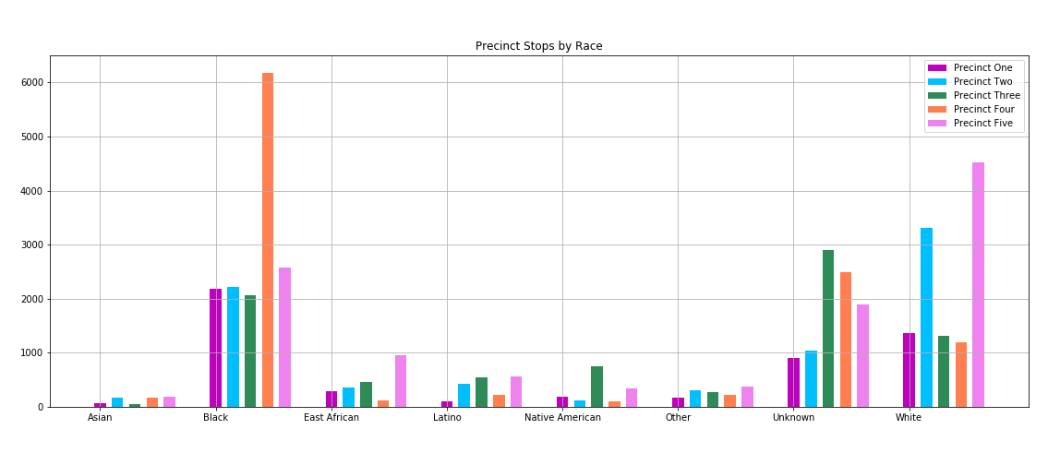
Data Exploration - Overview
Notes:
Describe the exploration and cleanup process:
read the file into a pandas data frame, observed n/a values.
Discuss insights you had while exploring the data that you did not anticipate:
accuracy of race identification
Discuss any problems that arose after exploring the data, and how you resolved them:
n/a values – researched through MN website; figuring out how to deal with date timestamps

Slide 6
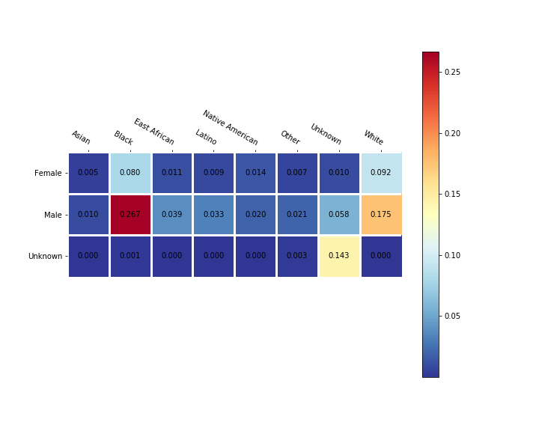
Data Exploration - Overview
Notes:
Describe the exploration and cleanup process:
read the file into a pandas data frame, observed n/a values.
Discuss insights you had while exploring the data that you did not anticipate:
accuracy of race identification
Discuss any problems that arose after exploring the data, and how you resolved them:
n/a values – researched through MN website; figuring out how to deal with date timestamps

Slide 7
Data Analysis – Raleigh and James write, team edit
Discuss the steps you took to analyze the data and answer each question you asked in your proposal

Slide 8
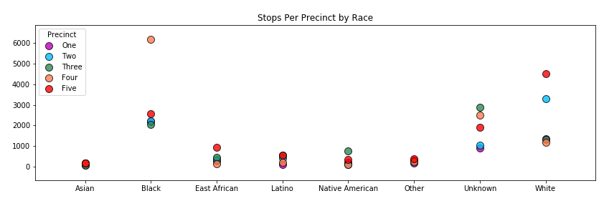
Data Analysis Are there proportional differences in race given the stops recorded by precinct? What about gender?

Slide 9
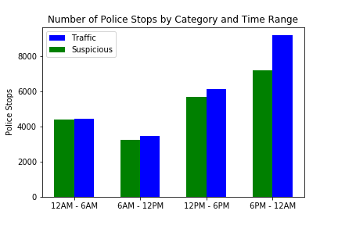
Data Analysis Are there more stops during the morning, afternoon, evening or night shifts?
Notes:
Describe the exploration and cleanup process:
read the file into a pandas data frame, observed n/a values.
Discuss insights you had while exploring the data that you did not anticipate:
accuracy of race identification
Discuss any problems that arose after exploring the data, and how you resolved them:
n/a values – researched through MN website; figuring out how to deal with date timestamps

Slide 10
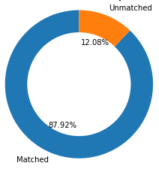
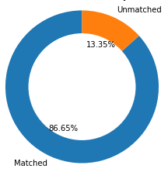
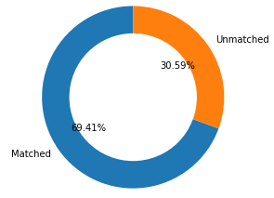
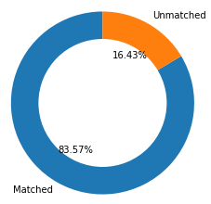

Data Analysis What is the likelihood that the pre-race determination matched the actual race documented after the stop?
Precinct
1
Precinct
2
Precinct
3
Precinct
4
Precinct
5
Notes:
Describe the exploration and cleanup process:
read the file into a pandas data frame, observed n/a values.
Discuss insights you had while exploring the data that you did not anticipate:
accuracy of race identification
Discuss any problems that arose after exploring the data, and how you resolved them:
n/a values – researched through MN website; figuring out how to deal with date timestamps

Slide 11
Data Analysis Does the type of police stop (traffic vs suspicious) impact whether a person is searched?
TBD
Notes:
Describe the exploration and cleanup process:
read the file into a pandas data frame, observed n/a values.
Discuss insights you had while exploring the data that you did not anticipate:
accuracy of race identification
Discuss any problems that arose after exploring the data, and how you resolved them:
n/a values – researched through MN website; figuring out how to deal with date timestamps

Slide 12
Findings – Raleigh and James write, team edit
Discuss your findings. Did you find what you expected to find? If not, why not? What inferences or general conclusions can you draw from your analysis?

Slide 13
Post Mortem – Team writes, edits
Discuss any difficulties that arose, and how you dealt with them
Incorporating census data / timeframe of that data compared to our data set
Census data may not correlate to traffic stops given that not everyone stopped is a resident of the area where they were stopped
Discuss any additional questions that came up, but which you did not not have time to answer
What would you research next if you had two more weeks?

Slide 14
Questions

